Slide 1
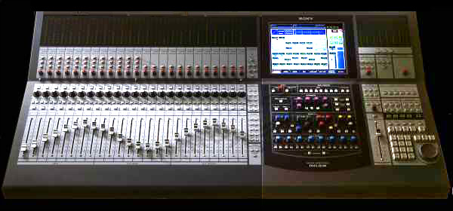
Mixing channels in the Web Audio API

Slide 2
Up-mixing and down-mixing
Up-mixing: converting audio from a smaller to a larger number of channels
Down-mixing: converting audio from a larger to a smaller number of channels
three interrelated AudioNode properties,
channelCount
channelCountMode
channelInterpretation
Notes:
It represents an audio source whose output is a constant value. It is useful as a constant source in general, and can be used as if it were a constructible AudioParam by automating its offset or connecting another node to it.
It is an audioScheduledSourceNode, meaning that its start() method must be called in order for it to output nonzero values.
The single output of this node consists of one channel (mono).
The ConstantSourceNode has a single a-rate parameter, offset, with default value of 1. It specifies the constant value of the source.
This simple node is actually one with a lot of uses. By having it as one of two or more inputs to a gain node, it acts like an adder, adding the offset to the input. By having it as input to the gain parameter of a gain node, it acts like a multiplier, multiplying the input by the offset. And as we shall see, it can be used to set parameter values for many nodes with one ConstantSource.

Slide 3
Channel count
channelCount: # channels used when up-mixing & down-mixing inputs to the node
channelCountMode: how channels counted when up-mixing & down-mixing inputs. Gives computedNumberOfChannels that controls how inputs mixed
"explicit": computedNumberOfChannels is channelCount
"max“ (default): computedNumberOfChannels is maximum # channels of all connections to input
"clamped-max": computedNumberOfChannels is minimum of "max" and channelCount
channelInterpretation: how individual channels treated when up-mixing and down-mixing connections to any inputs to the node
‘discrete’ maps input to output channels
Extra input channels dropped, extra output channels silent
"speakers" up-mixing and down-mixing defined for specific channel layouts

Slide 4
Channels in speaker layouts
Speaker Layout | Channel
 | 0 | 1 | 2 | 3 | 4 | 5
Mono | M:mono
Stereo | L: left | R: right
Quad | L: left | R: right | SL: surround left | SR: surround right
5.1 | L: left | R: right | C: Center | LFE: subwoofer | SL: surround left | SR: surround right

Slide 5
Up-mixing
Up-mix type | Notation | Description | Output
 |  |  | y_{L} | y_{R} | y_{C} | y_{LFE} | y_{SL} | y_{SR}
Mono | 1→2 | Mono to Stereo | x | x
 | 1→4 | Mono to Quad | x | x |  |  | 0 | 0
 | 1→5.1 | Mono to 5.1 | x | x | 0 | 0 | 0 | 0
Stereo up-mix | 2→4 | Stereo to Quad | x_{L} | x_{R} |  |  | 0 | 0
 | 2→5.1 | Stereo to 5.1 | x_{L} | x_{R} | 0 | 0 | 0 | 0
Quad up-mix | 4→5.1 | Quad to 5.1 | x_{L} | x_{R} | 0 | 0 | x_{SL} | y_{SR}

Slide 6
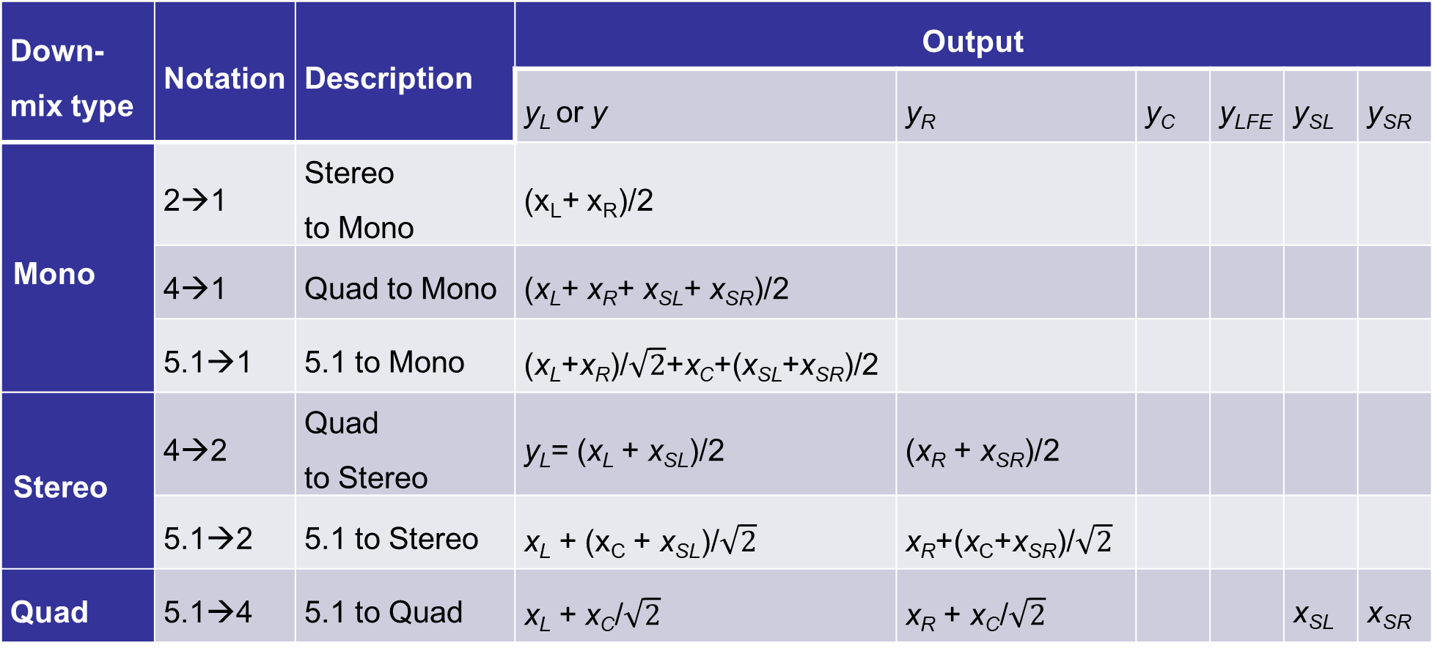
Down-mixing
Down-mix type | Notation | Description | Output
 |  |  | y_{L} or y | y_{R} | y_{C} | y_{LFE} | y_{SL} | y_{SR}
Mono | 2→1 | Stereo to Mono | (x_{L}+ x_{R})/2
 | 4→1 | Quad to Mono | (x_{L}+ x_{R}+ x_{SL}+ x_{SR})/2
 | 5.1→1 | 5.1 to Mono | (x_{L}+x_{R})/$\sqrt{2}$+x_{C}+(x_{SL}+x_{SR})/2
Stereo | 4→2 | Quad to Stereo | y_{L}= (x_{L} + x_{SL})/2 | (x_{R} + x_{SR})/2
 | 5.1→2 | 5.1 to Stereo | x_{L} + (x_{C} + x_{SL})/$\sqrt{2}$ | x_{R}+(x_{C}+x_{SR})/$\sqrt{2}$
Quad | 5.1→4 | 5.1 to Quad | x_{L} + x_{C}/$\sqrt{2}$ | x_{R} + x_{C}/$\sqrt{2}$ |  |  | x_{SL} | x_{SR}

Slide 7
Examples
Gain node to explicit 2-channels (stereo)
gain.channelCount = 2
gain.channelCountMode="explicit"
gain.channelInterpretation="speakers"
Hardware output to 5.1 to play HTMLAudioElement
context.destination.channelCount = 6
context.destination.channelCountMode = "explicit"
context.destination.channelInterpretation = "speakers"
Hardware output to 4-channels for DJ-app with 2 stereo output busses
context.destination.channelCount = 4
context.destination.channelCountMode = "explicit"
context.destination.channelInterpretation = "discrete"
Hardware output to 8-channels for custom multichannel speaker array
context.destination.channelCount = 8
context.destination.channelCountMode = "explicit"
context.destination.channelInterpretation = "discrete"
Explicitly down-mix to mono.
gain.channelCount = 1
gain.channelCountMode = "explicit"
gain.channelInterpretation="speakers"

Slide 8
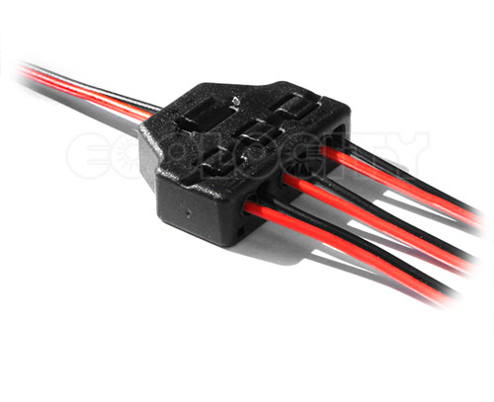
Channel splitting and merging in the Web Audio API

Slide 9

ChannelSplitterNode
Separate channels of single input signal into several mono outputs
single input
# active outputs = # channels in input signal
useful for accessing each channel separately
perform channel mixing where gain must be separately controlled on each channel
One parameter, numberOfOutputs
ChannelSplitter
Example: stereo input → 2 outputs (one each from left & right channels)
var splitter= new ChannelSplitterNode(context,{numberOfOutputs:2})
or
var splitter = context.createChannelSplitter(2);

Slide 10
ChannelMergerNode
combine multiple audio streams to single multichannel audio stream
one parameter, numberOfInputs
single output stream with # channels = # inputs
Each input downmixed to one channel (mono) based on specified mixing rule
Example: two stereo inputs
Each input downmixed to mono before merging
output is 6-channel stream whose first two channels are first two (downmixed) inputs, other channels silent
ChannelMerger
var merge= new ChannelMergerNode(context,{numberOfInputs:2})
or
var merge = context.createChannelMerger(2);

Slide 11
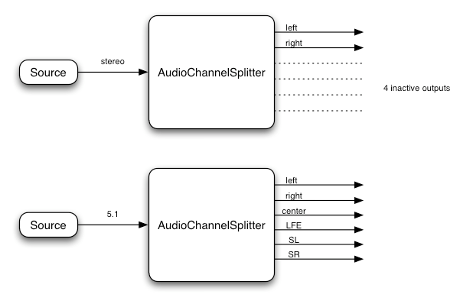
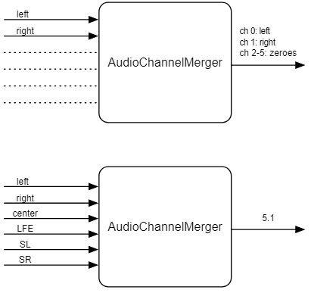
ChannelSplitter and ChannelMerger
4 inactive outputs
4 inactive inputs

